Slide 1
Images for 3D kd and source identification

Slide 2
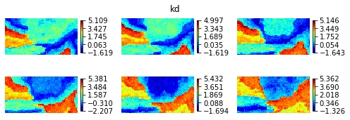
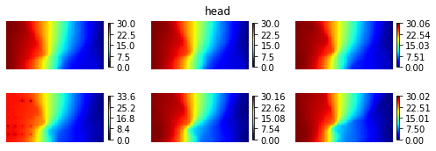
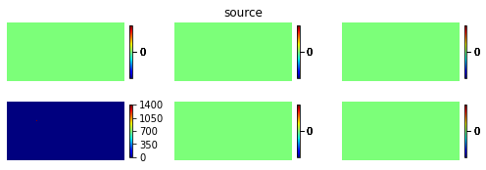
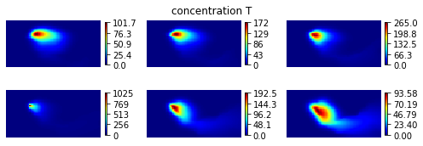
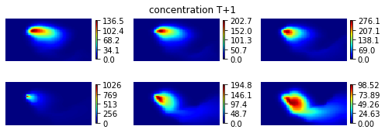
Autoregressive
model
auto_reg.pdf

Slide 3
Bayesian_nn_test.pdf in thesis

Slide 4
Histograms of
Reference
Scenario 1:
CAAE-MT3DMS-ESMDA
Scenario 2:
CAAE-DenseED-ESMDA
logk_esmda.pdf

Slide 5
CAAE_test.pdf

Slide 6
Reference
Posterior Mean
Posterior STD
Posterior sample 1
Posterior sample 2
Posterior sample 3
ESMDA_kd_960.pdf in thesis

Slide 7
errorbars.pdf

Slide 8
Head_well.pdf

Slide 9
105 pixels
180 pixels
150 pixels
logk_training.pdf

Slide 10
logk_head.pdf

